Slide 1
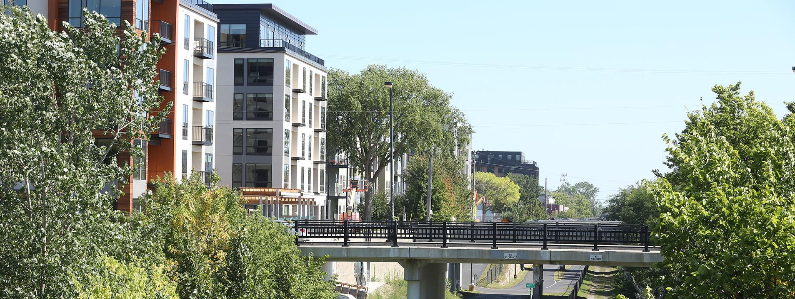
Metro Inn Purchase for Protective Housing
How to set your image in the placeholder
Right click image and select “format picture”
Select “Picture” tab
Select Crop from the drop down menu
Under Picture Position, use the Offset X and Offset Y to position your image within the frame
delete this when no longer needed
Hennepin County Housing and Economic Development
Notes:
Michelle introduce Windom team
Michelle: goals of meeting (update, timeline, community engagement opportunities, questions/concerns)
Greene: Timeline and details
Mario moderating / focus on Metro
Many will call in – don’t rely on ppt too heavily
MG: TY to Core Team, Windom Council, Cmsr. Greene
MG: Introduce Julia Welle Ayres, Laura Hoffman.

Slide 2
Project Overview
COVID-19 has made the need for housing even more urgent
Protective housing provides safe living spaces for vulnerable populations during the pandemic
The county’s Housing and Redevelopment wants to buy the Metro Inn Motel, to convert it to protective housing
Notes:
Community crisis. We’re not able to control it, but we can manage it to the best of our ability.

Slide 3
County Housing Response to COVID-19
March to September
Leased hotels to deconcentrate shelters and protect people most vulnerable to COVID-19
Nurses selected people in shelter who were seniors or had underlying medical problems
County launched “Hotels to Housing Program”
County explored possible acquisitions to replace leases

Slide 4
Metro Inn Motel Timeline (2020)
Cmsr. Greene reaches out to Windom Neighborhood – September 24
Board (HRA) authorizes negotiations – September 29
Cmsr. Greene meets with Windom Workgroup – October 7 (weekly meetings since then)
Deal struck/Due diligence/Closing date – October 19 – December 1
Competitive selection of facility operator (Windom resident on selection committee) – started 10/12, concluded 10/28
Closing – by December 1
Building repairs – December
Residents move in from county-leased hotels – by December 30
Notes:
Repairs: ducting and airflow, partitions, new paint, and carpet. Safety updates will includes new locks and outside lighting and security cameras for the property. Parking lot, roof, and gutter repairs.

Slide 5
Metro Inn Motel in 2021
24-hour on-site management
Code of conduct – resident signature required
Ongoing open lines of communication and regular meetings between neighborhood and property manager
Continued conversations between neighborhood and County on best use of property after pandemic

Slide 6
Q and A

Slide 7
Laura Hoffman
Laura.Hoffman@hennepin.us, 612-348-0863
District 3 Aide to Commissioner Marion Greene

